Slide 1
Information And Cyber Security

Slide 2
University Syllabus
Savitribai Phule Pune University
Fourth Year of Information Technology (2015 Course)
414453: Information and Cyber Security
Teaching Scheme:
TH:03 Hours/Week Credits: 03 Examination Scheme:
In-Sem (Paper): 30 Marks
End-Sem (paper): 70 Marks
Prerequisites:
1. Data Communication.
2. Computer Network.
Course Objectives:
1. Understand computer, network and information security.
2. To study operating system security and malwares.
3. To study security issues in internet protocols.
4. To study network defence tools.
5. To learn forensics and investigation techniques.
Course Outcomes:
By the end of the course, students should be able to
1. Use basic cryptographic techniques in application development.
2. Apply methods for authentication, access control, intrusion detection and prevention.
3. To apply the scientific method to digital forensics and perform forensic investigations.
4. To develop computer forensics awareness.
5. Ability to use computer forensics tools.

Slide 3
Course Contents
Unit I SECURITY BASICS 7 Hrs
Information Security Concepts, Security Threats and Vulnerabilities, Security Architectures and Operational Models, Types of Security attacks, Goals of Security, Malicious code, Intrusion detection system (IDS): Need, Types, Limitations and Challenges, security and privacy.
Unit II SYMMETRIC AND ASYMMETRIC KEY CRYPTOGRAPHY 7Hrs
Introduction, Classical Encryption Techniques, Block Ciphers and Data Encryption standards, Advanced Encryption standard, Public Key Cryptography and RSA, Chinese Remainder Theorem, Diffie-Hellman, Elgamal Curve Arithmetic, Elliptic Curve Arithmetic, Elliptic Curve Cryptography.
Unit III DATA INTEGRITY ALGORITHMS AND SECURITY REQUIREMENTS 7 Hrs
Cryptographic Hash Functions, requirements and security, SHA-1, SHA-3, Digital Signatures, X.509 Certificate, Kerberos, IP Security: Architecture Protocols IPv4, IPv6, AH, EPS, ISAKMP, Web Security: SSL, HTTPS, Mail Security: PGP, S/MIME
Unit IV LEGAL, ETHICAL, AND PROFESSIONAL ISSUES IN INFORMATION SECURITY, RISK MANAGEMENT 7 Hrs

Slide 4
Overview, Risk identification, Risk Assessment, Risk Control Strategies, Quantitative vs. Qualitative Risk Control Practices. Risk Management. Laws and Ethics in Information Security, Codes of Ethics, Protecting programs and data.
Unit V INTRODUCTION TO CYBER LAWS 7 Hrs
Introduction, Definition and origin, Cybercrime and Information security, Classification of Cybercrimes, The legal perspectives- Indian perspective, Global perspective, Categories of Cybercrime, Types of Attacks, a Social Engineering, Cyber stalking, Cloud Computing and Cybercrime.
Unit VI TOOLS AND METHODS USED IN CYBERCRIME 7 Hrs
Introduction, Proxy servers and Anonymizers, Phishing, Password Cracking, Key-loggers and Spywares, Types of Virus, Worms, Dos and DDoS, SQL injection, Cybercrime and Legal perspectives, Cyber laws- Indian context, The Indian IT Act-Challenges, Amendments, Challenges to Indian Law and cybercrime Scenario in India, Indian IT Act and Digital Signatures. study of any two network security scanners: Nmap, Metasploit, OpenVAS, Aircrack, Snort, Wireshark, Nikito, Samurai, Safe 3 etc.

Slide 5
Books
William Stallings, Computer Security : Principles and Practices, Pearson 6th Ed, ISBN: 978-0-13-335469-0
2. Nina Godbole, Sunit Belapure , Cyber Security- Understanding Cyber Crimes, Computer Forensics and Legal Perspectives, Wiely India Pvt.Ltd, ISBN- 978-81-265-2179-1
3. Bernard Menezes, Network Security and Cryptography, Cengage Learning , ISBN-978-81-315-1349-1
4. Dr. V.K. Pachghare, Cryptography and Information security, PHI, Second edition, ISBN- 978-81-203-5082-3
Reference Books
1. Bruice Schneier , Applied Cryptography- Protocols, Algorithms and Source code in C, Algorithms, Wiely India Pvt Ltd, 2nd Edition, ISBN 978-81-265-1368-0.
2. Nina Godbole , Information Systems Security , Wiley India Pvt. Ltd, ISBN -978-81-265-1692-6
3. CK Shyamala et el., Cryptography and Security, Wiley India Pvt. Ltd, ISBN-978-81-265-2285-9.
4. Berouz Forouzan, Cryptography and Network Security, TMH, 2 edition, ISBN -978-00-707-0208-0.
5. Mark Merkow, Information Security-Principles and Practices, Pearson Ed., ISBN- 978-81-317-

Slide 7
Unit-1: Security Fundamentals
The words Data and Information may look similar and many people use these words very frequently, But both have lots of differences between them.
what is data: Data are plain facts or text.
The word "data" is plural for "datum." When data are processed, organized, structured or presented in a given context so as to make them useful, they are called Information.
Data themselves are fairly useless, but when these data are interpreted and processed to determine its true meaning, they becomes useful and can be named as Information.

Slide 8
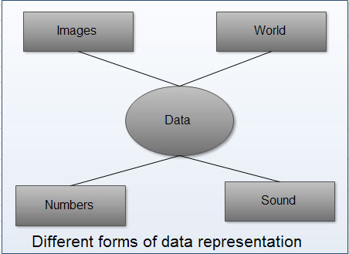
Conti…
Information is data that has been processed in such a way as to be meaningful to the person who receives it. it is any thing that is communicated.
Data is the name given to basic facts and entities such as names and numbers. The main examples of data are weights, prices, costs, numbers of items sold, employee names, product names, addresses, tax codes, registration marks etc.
Data is the raw material that can be processed by any computing machine. Data can be represented in the form of: Numbers and words which can be stored in computer's language
Images, sounds, multimedia and animated data as shown.

Slide 9
Conti…
Information: Information is data that has been converted into a more useful or intelligible form.
It is the set of data that has been organized for direct utilization of mankind, as information helps human beings in their decision making process.
Examples are: Time Table, Merit List, Report card, Headed tables, printed documents, pay slips, receipts, reports etc.

Slide 10
Conti…
The information is obtained by assembling items of data into a meaningful form.
For example, marks obtained by students and their roll numbers form data, the report card/sheet is the .information. Other forms of information are pay-slips, schedules, reports, worksheet, bar charts, invoices and account returns etc.
It may be noted that information may further be processed and/or manipulated to form knowledge. Information containing wisdom is known as knowledge.

Slide 11
Need of Information
With the advent of educational reforms in society, mankind is surrounded with a vast amount of data available.
Modem business management system has also rendered itself to bulk collection of data from various sources, that needs to be rearranged in a fashion so that it can be utilized with minimum possible time.
This needs a high amount of filing either at data stage or at information stage. No office can be without files.
Modem rules, regulation and law requires every transaction to happen in a written form, may be an agreement, application, voucher, bill, letter, memo, order etc.
Paper files require a high amount of storage space and paper storage creates several other problems like fire risk, spoilage and deterioration by way of aging microorganism and humidity etc.
In modem days information is needed to run man's own livelihood to run a system or process or to command a business.

Slide 12
Information is needed to:
• To gain knowledge about the surroundings, and whatever is happening in the society and universe.
• To keep the system up to date.
• To know about the rules and regulations and bye laws of society, local government, provincial and central government, associations, clients etc. as ignorance is no bliss.
• Based on above three, to arrive at a particular decision for planning current and prospective actions in process of forming, running and protecting a process or system
Source: http://ecomputernotes.com/fundamental/information-technology/what-do-you-mean-by-data-and-information

Slide 13
Information is an asset that has value like other asset.
As an asset, information needs to be secured from attacks.
To be secured, information needs to be hidden from unauthorized access (confidentiality), protected from unauthorized change (integrity) and available to an authorized entity when it is needed(availability).

Slide 14
IT Security Vulnerability vs Threat vs Risk: What’s the Difference?
In today’s world, data and protecting that data are critical considerations for businesses.
Customers want to ensure that their information is secure with you, and if you can’t keep it safe, you will lose their business.
Many clients with sensitive information actually demand that you have a rigid data security infrastructure in place before doing business with you.
With that consideration as the backdrop, how confident are you when it comes to your organization’s IT security?

Slide 15
In order to have a strong handle on data security issues that may potentially impact your business, it is imperative to understand the relationship and differences of three central components – Threat, Vulnerability and Risk. Frequently these technical terms are used interchangeably, but although related, they are distinct terms with different meanings and implications.

Slide 16
Threat
A threat refers to a new or newly discovered incident with the potential to do harm to a system or your overall organization.
There are three main types of threats –
natural threats (e.g., floods or a tornado),
unintentional threats (such as an employee mistakenly accessing the wrong information) and
intentional threats -There are many examples of intentional threats including spyware, malware, adware companies or the actions of a disgruntled employee. In addition, worms and viruses are also categorized as threats, because they could potentially cause harm to your organization through exposure to an automated attack, as opposed to one perpetrated by humans.

Slide 17
Most recently, on May 12, 2017, the WannaCry Ransomware Attack began bombarding computers and networks across the globe and has since been described as the biggest attack of its kind. Cyber criminals are constantly coming up with creative new ways to compromise your data as seen in the 2017 Internet Security Threat Report.

Slide 18
Although these threats are generally outside of one’s control and difficult to identify in advance, it is essential to take appropriate measures to assess threats regularly. Here are some ways to do so:
Although these threats are generally outside of one’s control and difficult to identify in advance, it is essential to take appropriate measures to assess threats regularly. Here are some ways to do so:
Ensure that your team members are staying informed of current trends in cybersecurity so they can quickly identify new threats. They should subscribe to blogs (like Wired) and podcasts (like Techgenix Extreme IT) that cover these issues as well as join professional associations so they can benefit from breaking news feeds, conferences and webinars.
You should also perform regular threat assessments to determine the best approaches to protecting a system against a specific threat, along with assessing different types of threats.
In addition, penetration testing involves modeling real-world threats in order to discover vulnerabilities.

Slide 19
Vulnerability
A vulnerability refers to a known weakness of an asset (resource) that can be exploited by one or more attackers.
In other words, it is a known issue that allows an attack to be successful. For example, when a team member resigns and you forget to disable their access to external accounts, change logins or remove their names from company credit cards, this leaves your business open to both intentional and unintentional threats. However, most vulnerabilities are exploited by automated attackers and not a human typing on the other side of the network.

Slide 20
Testing for vulnerabilities is critical to ensuring the continued security of your systems by identifying weak points and developing a strategy to respond quickly. Here are some questions to ask when determining your security vulnerabilities:
Is your data backed up and stored in a secure off-site location?
Is your data stored in the cloud? If yes, how exactly is it being protected from cloud vulnerabilities?
What kind of network security do you have to determine who can access, modify or delete information from within your organization?
What kind of antivirus protection is in use? Are the licenses current? Is it running as often as needed?
Do you have a data recovery plan in the event of a vulnerability being exploited?
Understanding your vulnerabilities is the first step to managing your risk.

Slide 21
Risk
Risk refers to the potential for loss or damage when a threat exploits a vulnerability. Examples of risk include financial losses as a result of business disruption, loss of privacy, reputational damage, legal implications and can even include loss of life.
Risk can also be defined as follows:
Risk = Threat X Vulnerability
You can reduce the potential for risk by creating and implementing a risk management plan. Here are the key aspects to consider when developing your risk management strategy:

Slide 22
strategy:
Assess risk and determine needs. When it comes to designing and implementing a risk assessment framework, it is critical to prioritize the most important breaches that need to be addressed. Although frequency may differ in each organization, this level of assessment must be done on a regular, recurring basis.
Include a total stakeholder perspective. Stakeholders include the business owners as well as employees, customers and even vendors. All of these players have the potential to negatively impact the organization (potential threats) but at the same time they can be assets in helping to mitigate risk.
Designate a central group of employees who are responsible for risk management and determine the appropriate funding level for this activity.
Implement appropriate policies and related controls and ensure that the appropriate end users are informed of any and all changes.
Monitor and evaluate policy and control effectiveness. The sources of risk are ever-changing which means your team must be prepared to make any necessary adjustments to the framework. This can also involve incorporating new monitoring tools and techniques.

Slide 23
Summary To summarize the concepts of threat, vulnerability and risk, let’s use the real-world example of a hurricane.
The threat of a hurricane is outside of one’s control. However, knowing that a hurricane could potentially hit can help business owners assess weak points and come up with an action plan to minimize the impact. In this scenario, a vulnerability would be not having a data recovery plan in place in the event that your physical assets are damaged as a result of the hurricane’s winds or heavy rains. The risk to your business would be the loss of information or a disruption in business as a result of not addressing your vulnerabilities.

Slide 24
Accurately understanding the definitions of these security components will help you to be more effective in designing a framework to identify potential threats, uncover and address your vulnerabilities in order to mitigate risk.
Source :
https://www.bmc.com/blogs/security-vulnerability-vs-threat-vs-risk-whats-difference/

Slide 25
Security Terminologies
Sender and Receiver
Suppose a sender wants to send a message to a receiver.
This sender wants to send the message securely:
She wants to make sure an eavesdropper cannot read the message.
Messages and Encryption
A message is plaintext (sometimes called cleartext). The process of disguising a message in such a way as to hide its substance is encryption.
An encrypted message is ciphertext.
The process of turning ciphertext back into plaintext is decryption. This is all shown in Figure 1.1.

Slide 26
Conti…
The art and science of keeping messages secure is cryptography, and it is practiced by cryptographers.
Figure 1.1 Encryption and Decryption.
Plaintext is denoted by M, for message, or P, for plaintext.
It can be a stream of bits, a text file, a bitmap, a stream of digitized voice, a digital video image...whatever.
As far as a computer is concerned, M is simply binary data.
The plaintext can be intended for either transmission or storage.
In any case, M is the message to be encrypted.

Slide 27
Conti…
Ciphertext is denoted by C.
It is also binary data: sometimes the same size as M, sometimes larger. (By combining encryption with compression, C may be smaller than M. However, encryption does not accomplish this.)
The encryption function E, operates on M to produce C. Or, in mathematical notation:
E(M) = C
In the reverse process, the decryption function D operates on C to produce M:
D(C) = M
Since the whole point of encrypting and then decrypting a message is to recover the original plaintext, the following identity must hold true:
D(E(M)) = M
Source: Applied Cryptography:Bruice Scheiner

Slide 28
The Security Architecture and Operational Models
The OSI Security Architecture:
-ITU-T International Telecommunication Union Telecommunucation Standerdisation Sector X.800 (It is service provided by a protocol layer of communicating open system, to ensure the enough security of the system/ organization or of data transfer) security architecture for OSI defines a systematic approach for providing security at each layer or it is a standard which provide systematic approach of defining and providing security requirements.

Slide 29
Definition Computer security, Network Security and Information Security
Computer Security: The protection afforded to an automated information system in order to attain the applicable objectives of preserving the integrity, availability, and confidentiality of information system resources(includes hardware, software, firmware
This definition introduces three key objectives that are at the heart of computer security:
• Confidentiality: This term covers two related concepts:
— Data confidentiality:1 Assures that private or confidential information is
not made available or disclosed to unauthorized individuals.
— Privacy: Assures that individuals control or influence what information
related to them may be collected and stored and by whom and to whom that information may be disclosed.

Slide 30
Computer Security Conti..
• Integrity: This term covers two related concepts:
— Data integrity: Assures that information and programs are changed only in a specified and authorized manner.
— System integrity : Assures that a system performs its intended function in an unimpaired manner, free from deliberate or inadvertent unauthorized
manipulation of the system.
• Availability: Assures that systems work promptly and service is not denied to authorized users.
These three concepts form what is often referred to as the CIA triad are, Formation/data, and telecommunications).

Slide 31
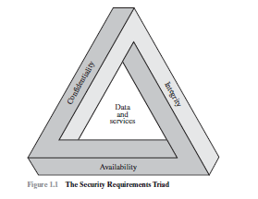
some in the security field feel that additional concepts are needed to present
a complete picture. Two of the most commonly mentioned are as follows:
• Authenticity: The property of being genuine and being able to be verified and
trusted; confidence in the validity of a transmission, a message, or message
originator. This means verifying that users are who they say they are and that
each input arriving at the system came from a trusted source.
• Accountability: The security goal that generates the requirement for actions
of an entity to be traced uniquely to that entity. This supports nonrepudiation,
deterrence, fault isolation, intrusion detection and prevention, and after-action
recovery and legal action. Because truly secure systems aren’t yet an achievable
goal, we must be able to trace a security breach to a responsible party. Systems
must keep records of their activities to permit later forensic analysis to trace
security breaches or to aid in transaction disputes.

Slide 32
Network Security
A network security system typically relies on layers of protection and consists of multiple components including networking monitoring and security software in addition to hardware and appliances. All components work together to increase the overall security of the computer network.
Scenario also includes security of data or information which is travelling in network.

Slide 33
Information Security
Information security (infosec) is the set of business processes that protects information assets regardless of how the information is formatted or whether it is being processed, is in transit or is being stored.
Good information security means that your personal data are protected against theft and misuse and that the data you need to do your job are available and accurate. Maintaining security will require you to take some precautions to protect yourself and the institution.

Slide 35
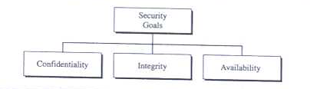
Security Goals
Authentication & Authorization: Authentication is the process of verifying the identity of a user by obtaining some sort of credentials and using those credentials to verify the user's identity. If the credentials are valid, the authorization process starts. Authentication process always proceeds to Authorization process.
Logging on to a PC with a username and password is authentication.
Authorization is the process of verifying that you have access to something. Gaining access to a resource (e.g. directory on a hard disk) because the permissions configured on it allow you access is authorization.

Slide 36
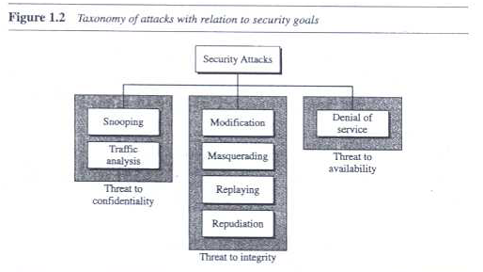
Security Attacks:
Our three goals of security- C, I and A can be threatened by security attacks.

Slide 37
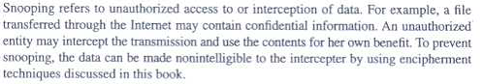
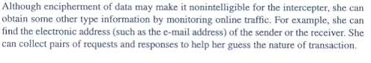
Security attacks conti..
Attacks threatening Confidentiality: 2 types
Snooping ii) Traffic analysis
i)Snooping-
ii) Taffic Analysis

Slide 38
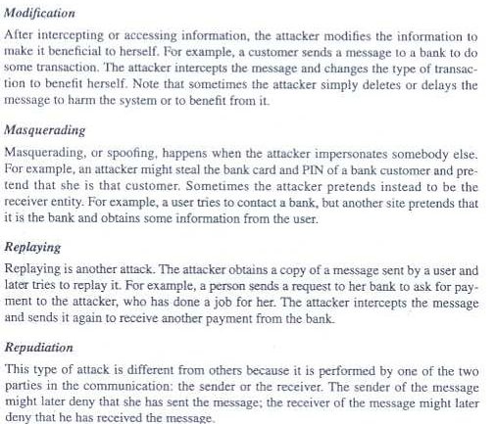
Attacks Threatening Integrity

Slide 39
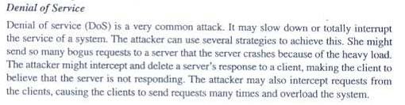
Attacks Threatening Availability

Slide 40
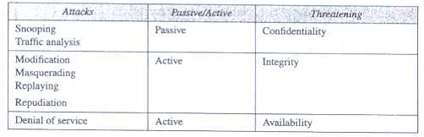
Passive Versus Active attacks
Lets now categorize the attacks into two groups:
Table shows relationship between this and previous categorization:

Slide 41
Passive attacks:
In passive attacks, the attackers goal is just to obtain information.
This means that the attack does not modify data or harm the system.
The system continues with its normal operation.
However the attack may harm sender or receiver of the message.
As the system is not affected it is very difficult to detect this type of attack until sender or receiver finds out about leaking of confidential info.
Passive attacks however can be prevented by encipherment of the data.
Eg. Snooping and traffic analysis

Slide 42
Active Attacks:
An active attack may change the data or harm the system.
This type of attacks are easier to detectthan prevent, because an attacker can launch them in variety of ways.
Eg. Integrity and availability

Slide 43
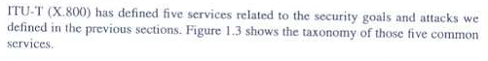
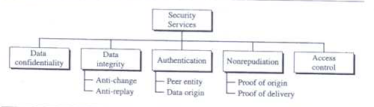
Services and mechanism

Slide 44
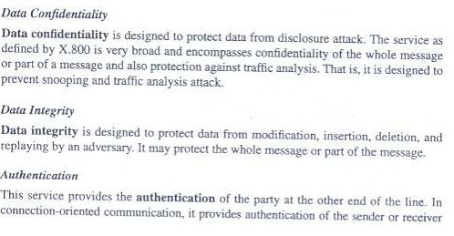

Slide 45
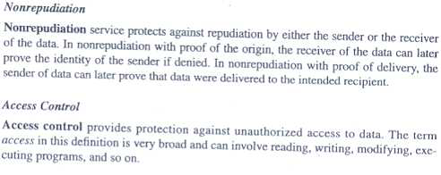

Slide 46
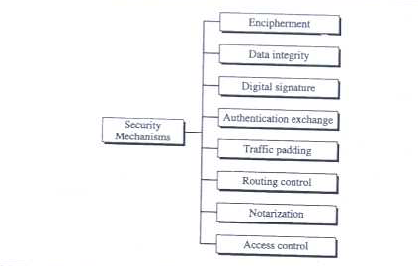
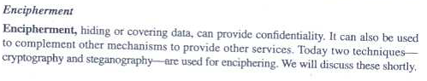
Security Mechanism

Slide 47
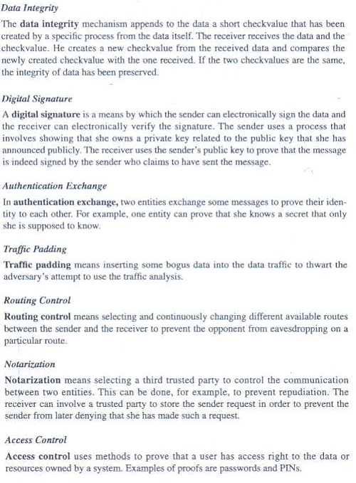

Slide 48
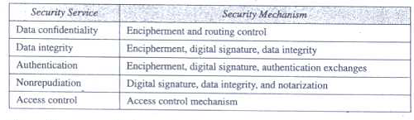
Relationship between security services and security mechanism

Slide 49
Security Techniques
Mechanism discussed till now are only theoretical recipes to implement security.
The actual implementation of security goals needs some techniques.
2 tech. are prevalent today: one is very general (Cryptography) and other is specific (steganography)
CRYPTOGRAPHY:
Some previously discussed security mechanism can be implemented using this.
This word is with Greek origin means “secret writing”
It is the science and art of transforming messages to make them secure and immune to attacks.
In past cryptography referred only to encryption and decryption of messages using secret keys.
Today it is defined as involving three distinct mechanism:
Symmetric Key Enciphermen t, Asymmetric Key Enciphermen t and Hashing

Slide 50
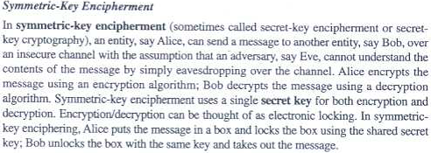
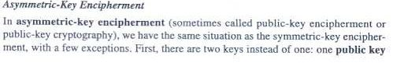

Slide 51
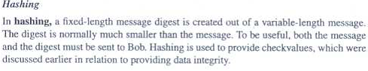
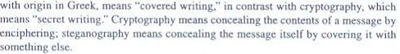
Steganography
Source:Cryptography and network security by Forouzan

Slide 52
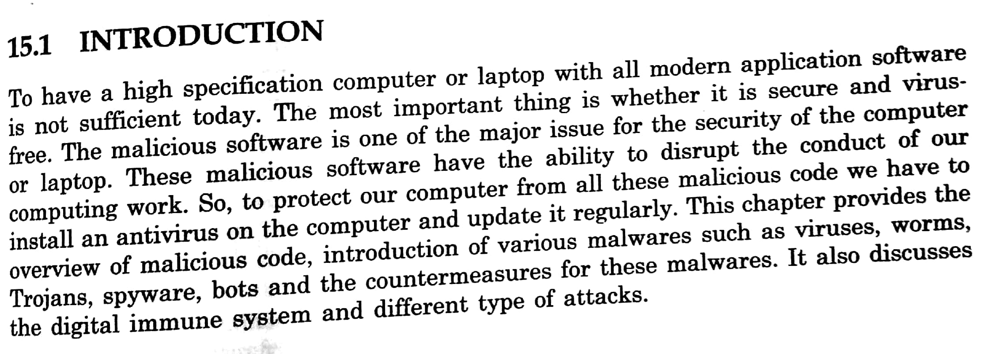
Malicious Code

Slide 53
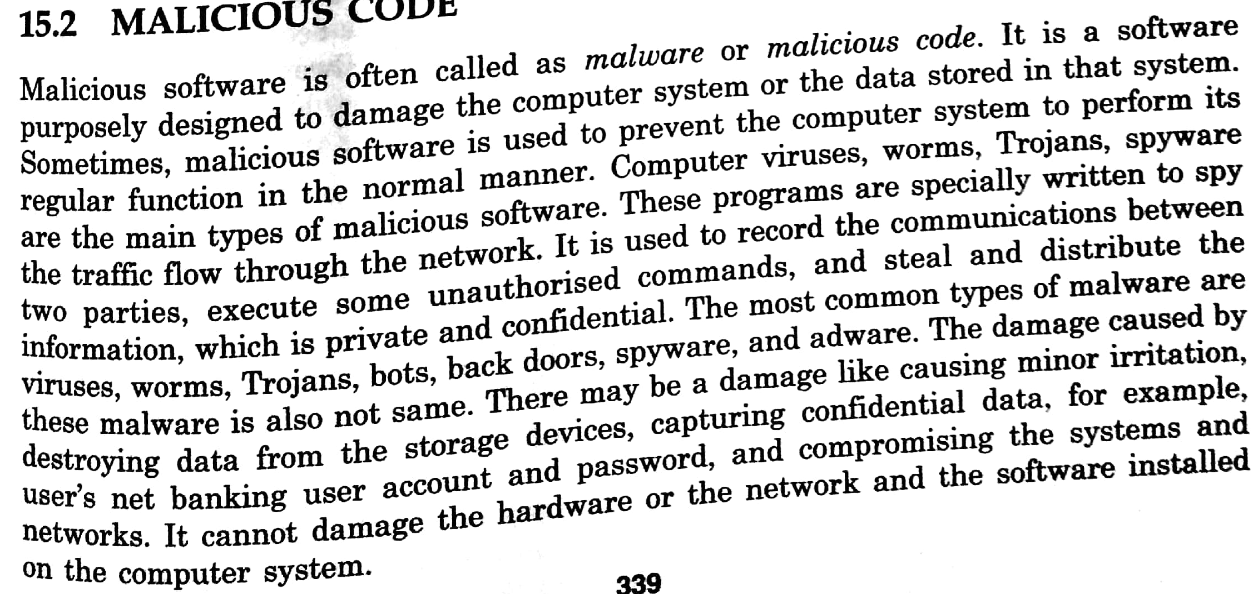

Slide 54
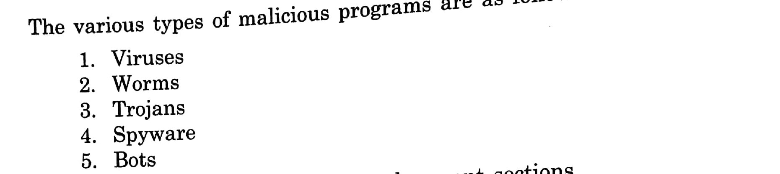

Slide 55
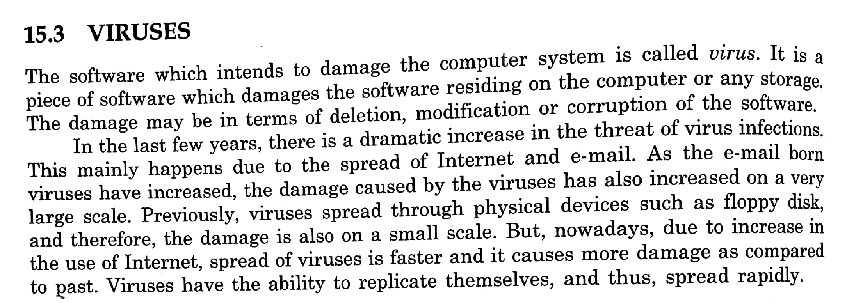

Slide 56
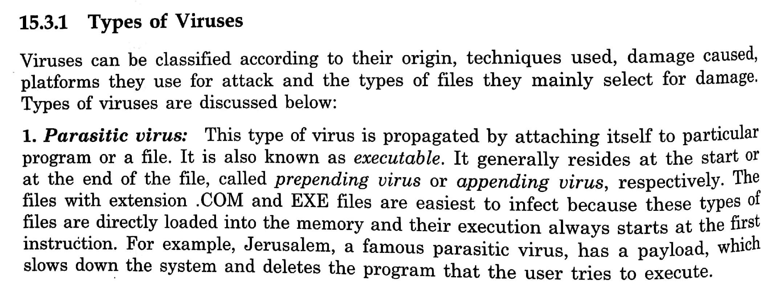

Slide 57
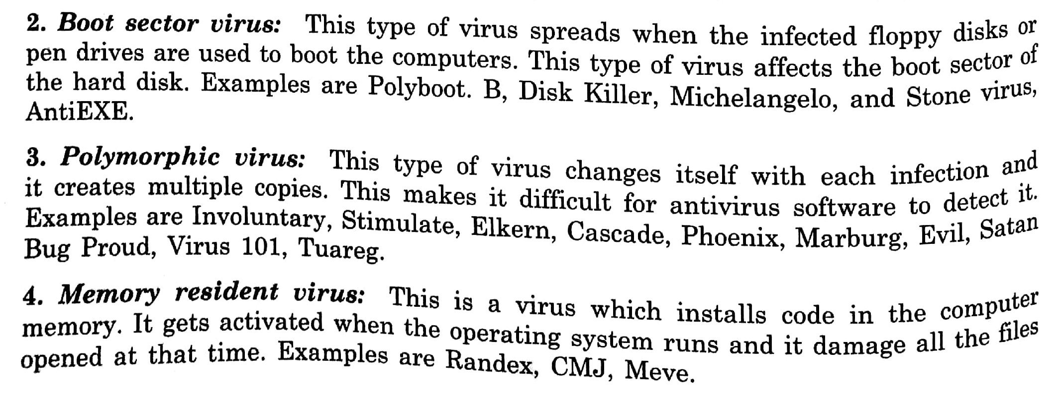

Slide 58
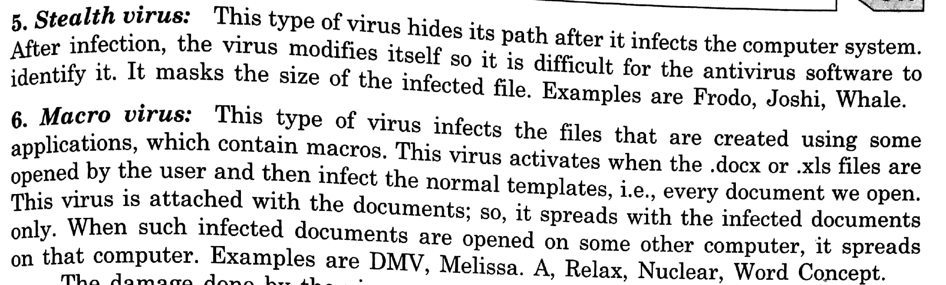

Slide 59
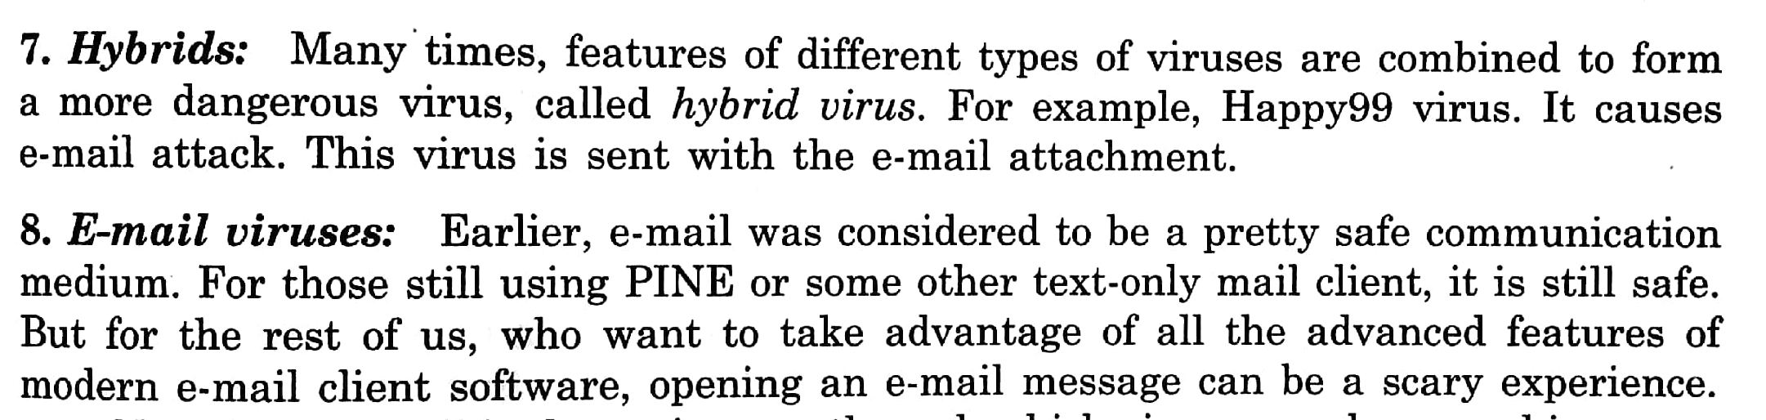

Slide 60
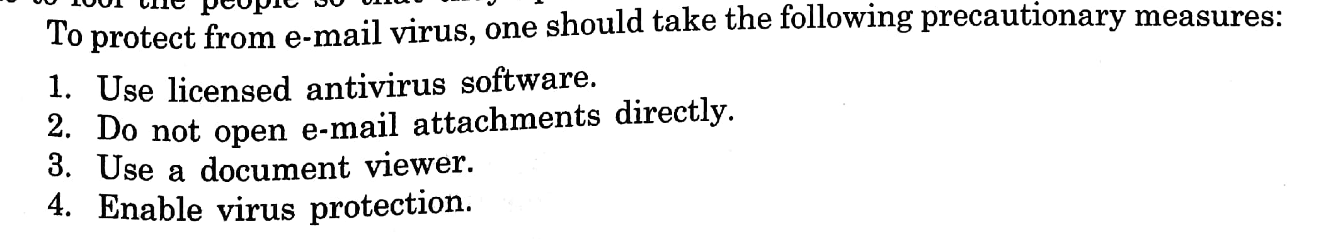

Slide 61
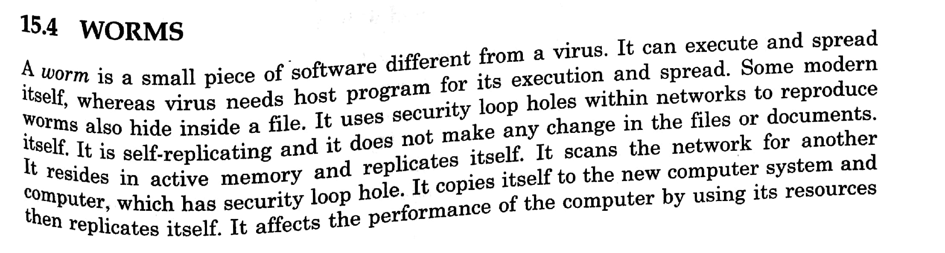

Slide 62
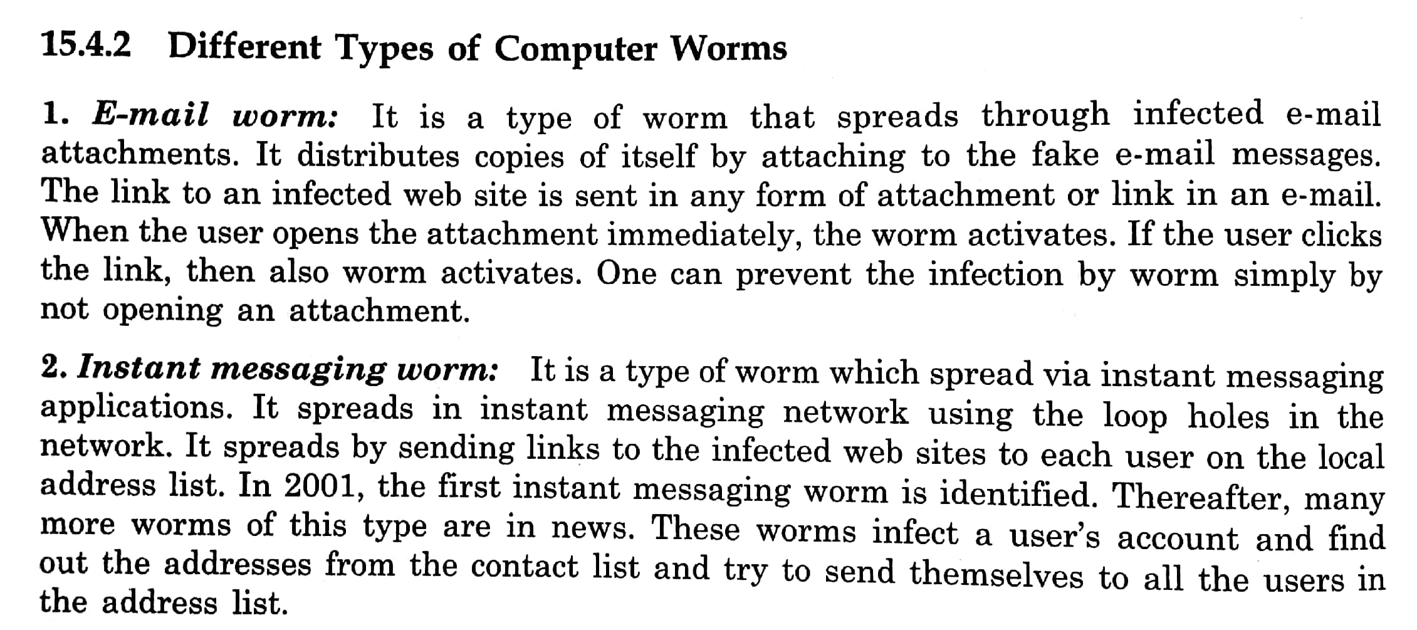

Slide 63
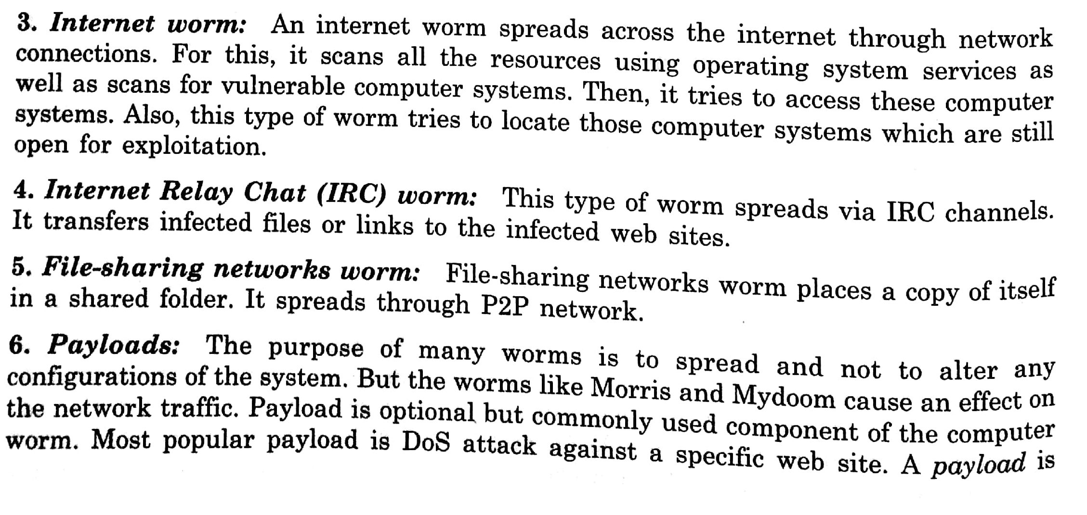

Slide 64
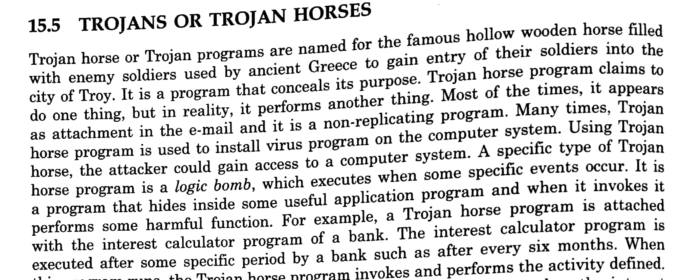

Slide 65
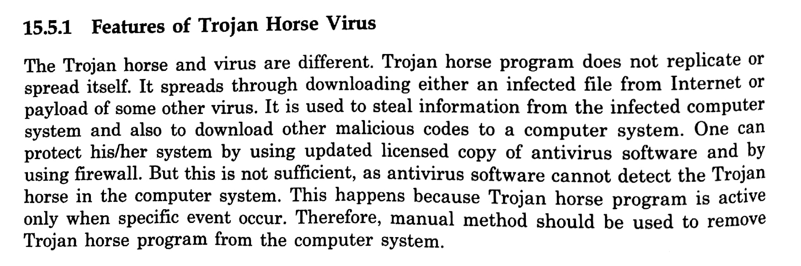

Slide 66
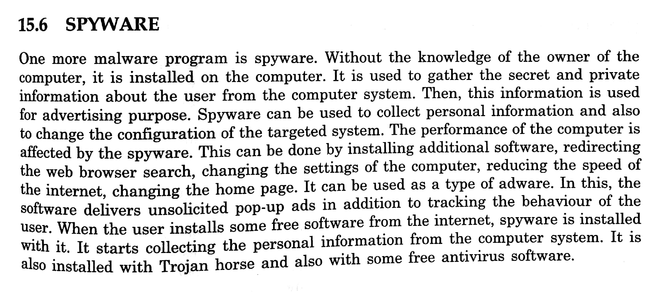

Slide 67
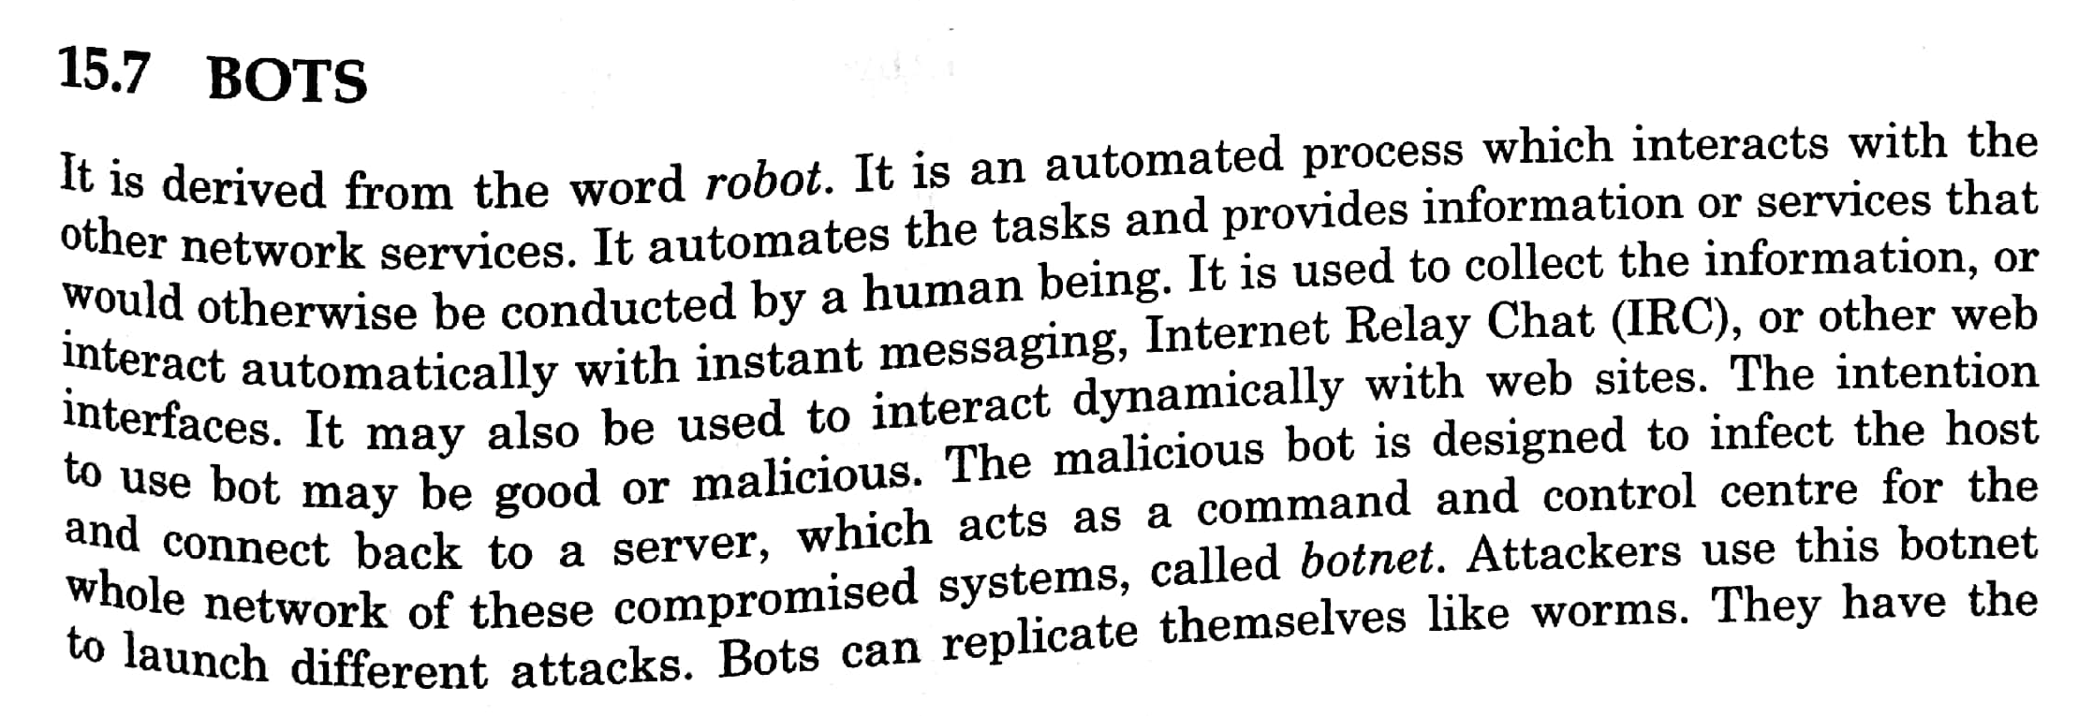

Slide 68
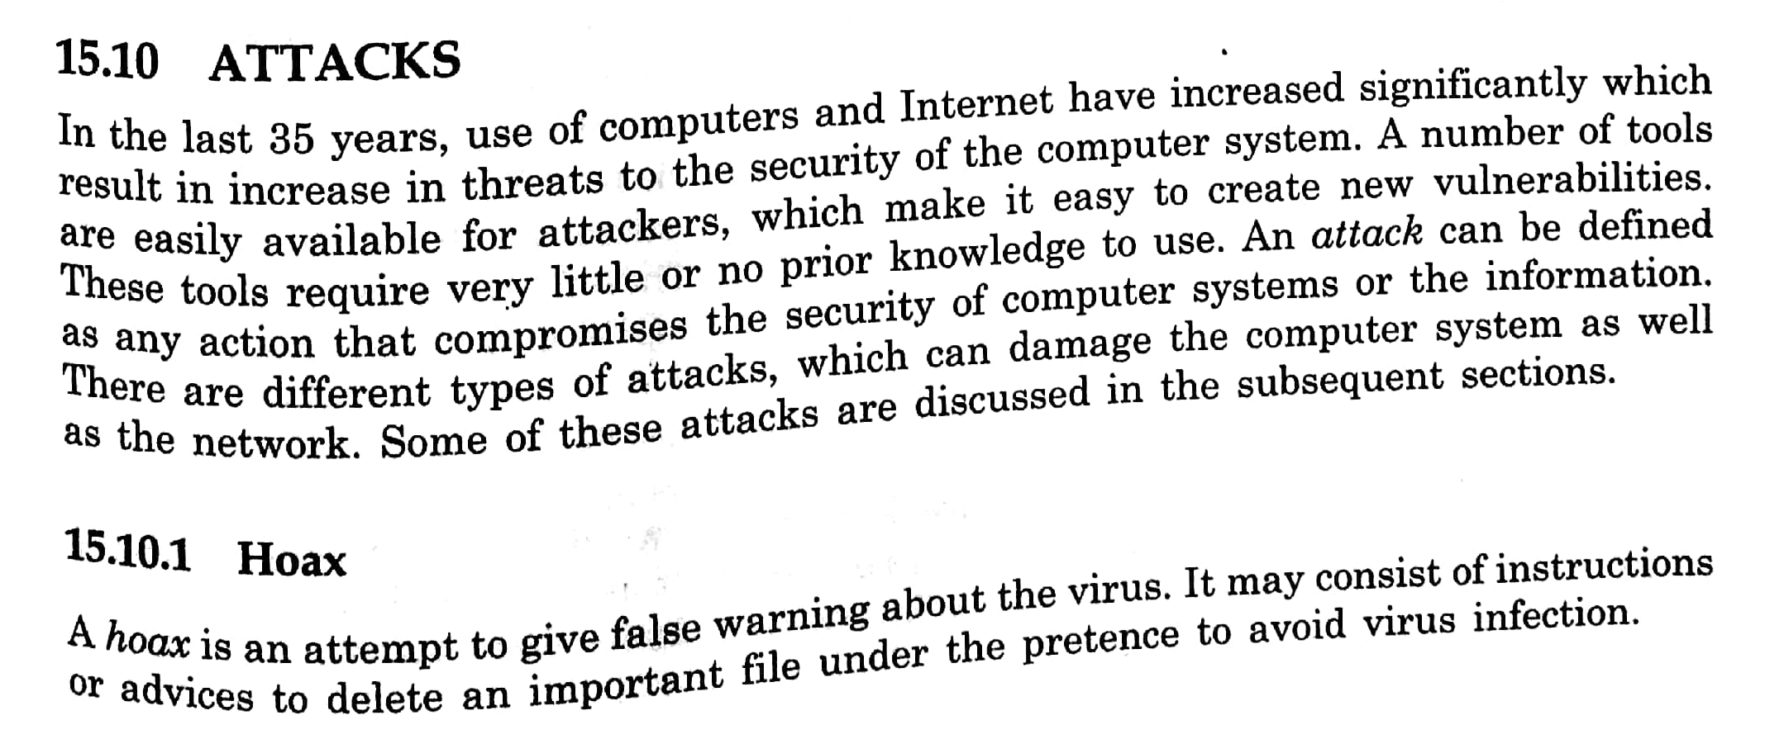

Slide 69
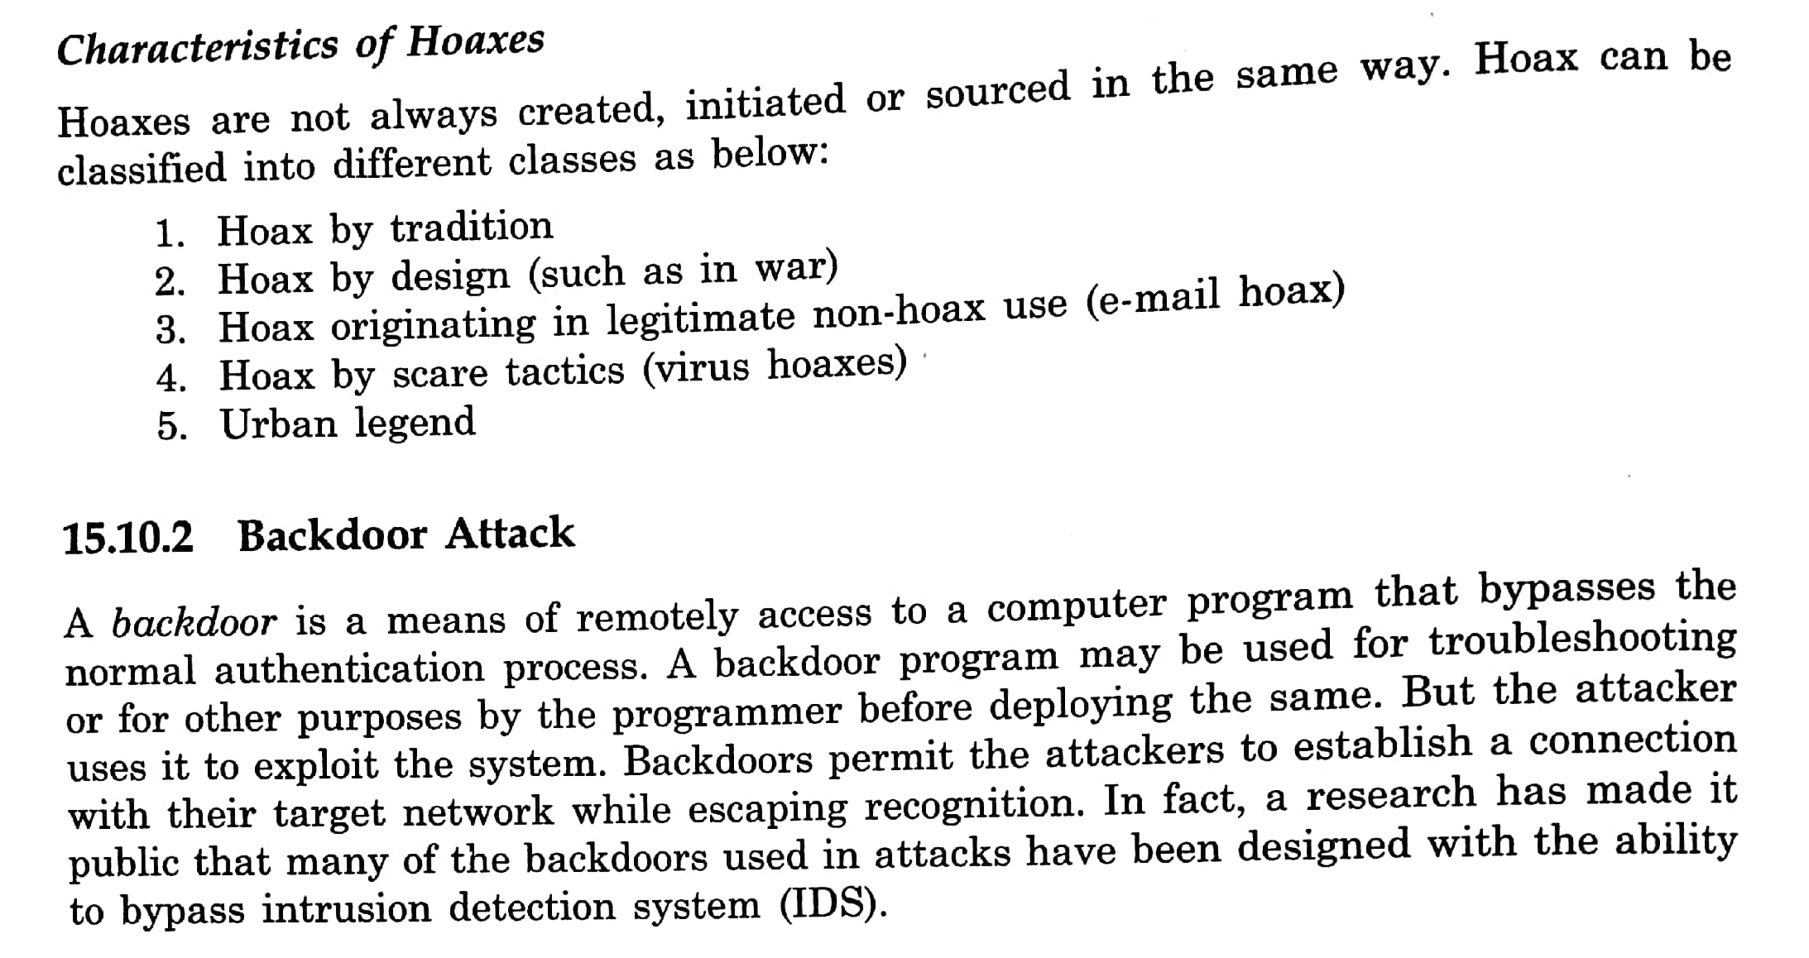

Slide 70
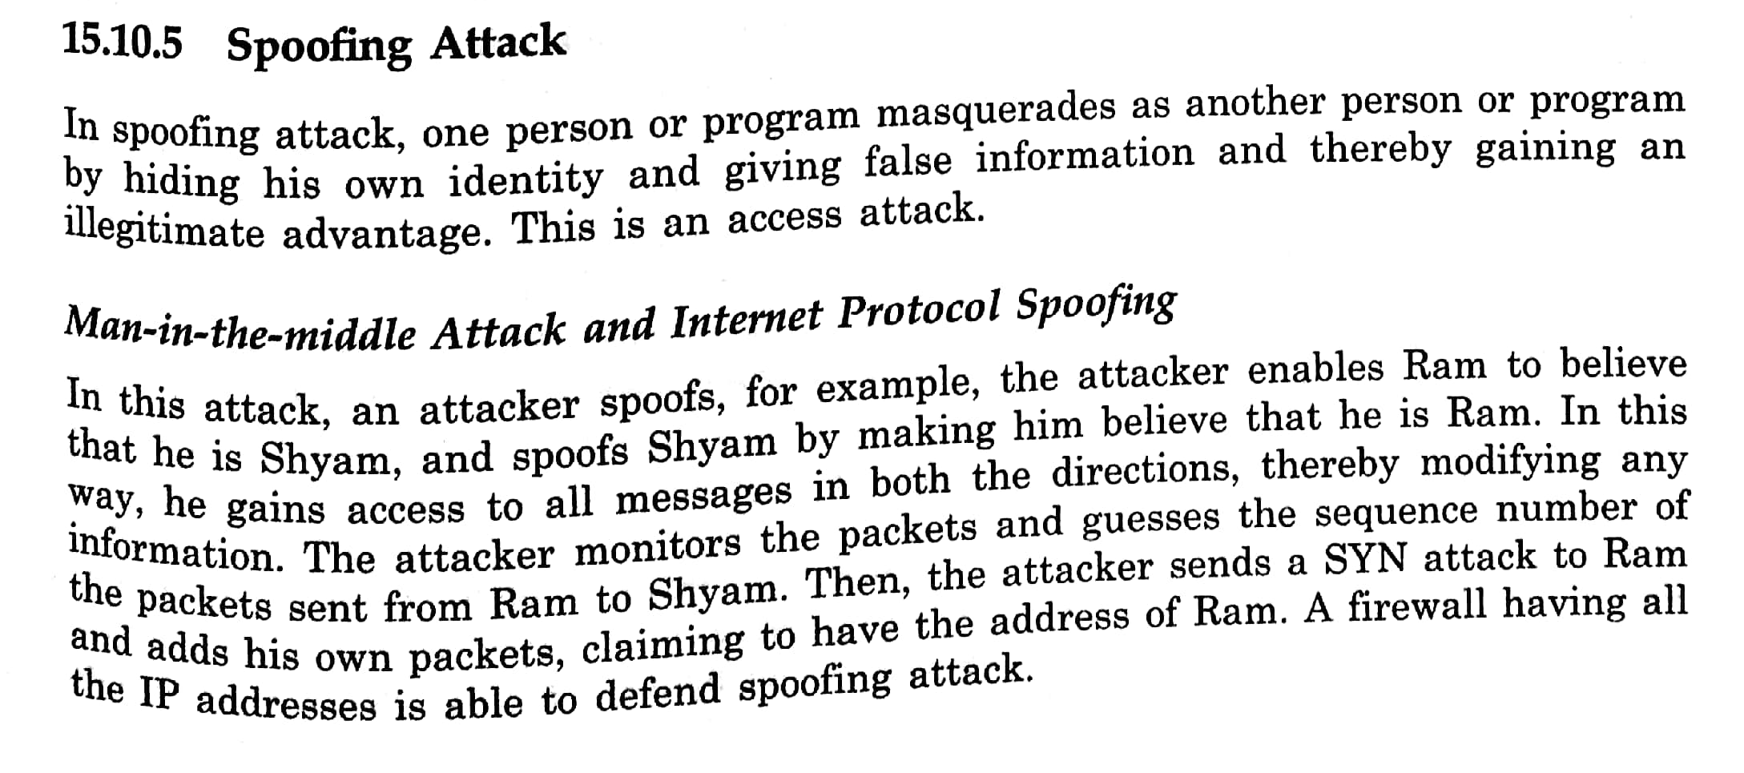

Slide 71
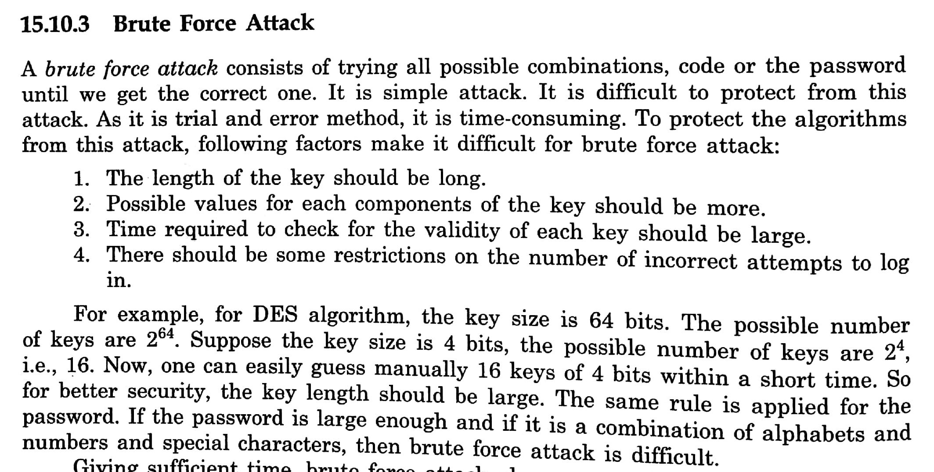

Slide 72
Spam- Many copies of the same message flood the internet in an attempt to force the message on the users
Email Bombing and spamming- is an attack by repeatedly sending the message through email to perticular address at specific target computer, may be large or meaningless data. To consume system and network resources.
Sniffer- is s/w that captures all the traffic flowing in both the directions i.e. into and out of computer attached to Network. It is also known as Network Protocol Analyser. It is used as network troubleshooting tool. The atttacker use sniffers to capture the packets flowing across the network to get information

Slide 73
Intrusion Detection

Slide 74
Information security is defined
as methods and technologies
for deterrence (scaring away hackers), protection, detection, response, recovery and extended functionalities

Slide 75
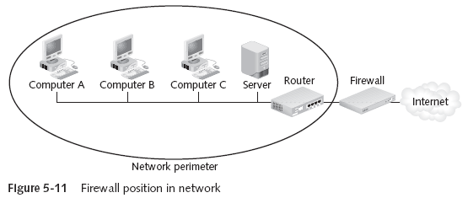
Overview of Existing Security Systems : Firewalls Used even for Deterring (Scaring attackers)
Firewalls → Designed to prevent malicious packets from entering
Software based → Runs as a local program to protect one computer (personal firewall) or as a program on a separate computer (network firewall) to protect the network
Hardware based → separate devices that protect the entire network (network firewalls)

Slide 76
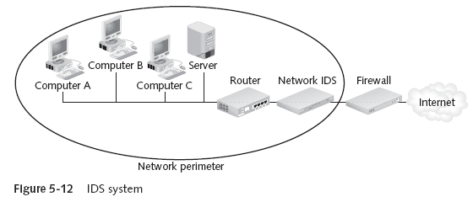
Overview of Existing Security Systems : Detection -Intrusion Detection Systems
Intrusion Detection System (IDS) → Examines the activity on a network
Goal is to detect intrusions and take action
Two types of IDS:
Host-based IDS → Installed on a server or other computers (sometimes all)
Monitors traffic to and from that particular computer
Network-based IDS → Located behind the firewall and monitors all network traffic

Slide 77
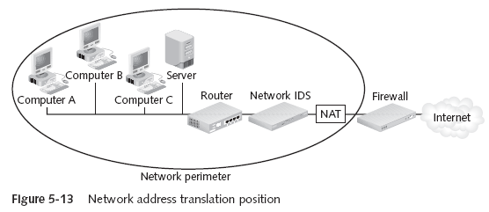
Overview of Existing Security Systems : Network Address Translation (NAT)
Network Address Translation (NAT) Systems → Hides the IP address of network devices
Located just behind the firewall. NAT device uses an alias IP address in place of the sending machine’s real one “You cannot attack what you can’t see”

Slide 78
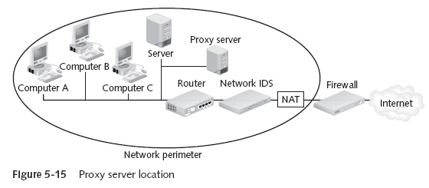
Overview of Existing Security Systems : Proxy Servers
Proxy Server → Operates similar to NAT, but also examines packets to look for malicious content Replaces the protected computer’s IP address with the proxy server’s address
Protected computers never have a direct connection outside the networkThe proxy server intercepts requests. Acts “on behalf of” the requesting client

Slide 79
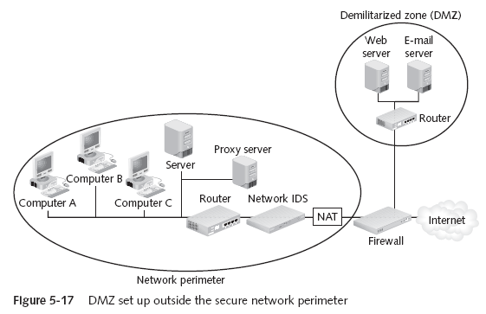
Adding a Special Network called Demilitarized Zone (DMZ)
Demilitarized Zones (DMZ) → Another network that sits outside the secure network perimeter. Outside users can access the DMZ, but not the secure network
Some DMZs use two firewalls. This prevents outside users from even accessing the internal firewall → Provides an additional layer of security

Slide 80
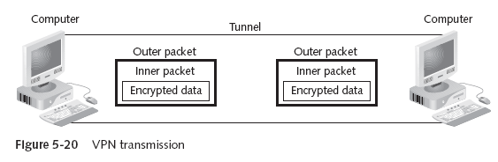
Overview of Existing Security Systems : Virtual Private Networks (VPN)
Virtual Private Networks (VPNs) → A secure network connection over a public network
Allows mobile users to securely access information
Sets up a unique connection called a tunnel

Slide 81
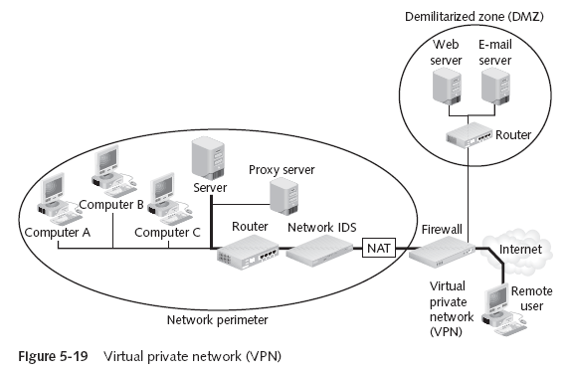
Overview of Existing Security Systems : Virtual Private Networks (VPN)

Slide 82
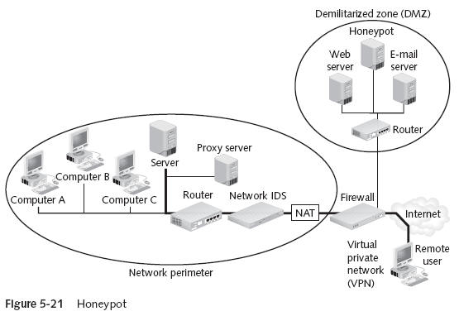
Overview of Existing Security Systems : Honeypots
Honeypots → Computer located in a DMZ and loaded with files and software that appear to be authentic, but are actually imitations
Intentionally configured with security holes
Goals: Direct attacker’s attention away from real targets; Examine the techniques used by hackers

Slide 83
Overview of Existing Security Systems : Secure Socket Layer (SSL)
SSL is used for securing communication between clients and servers. It provides mainly confidentiality, integrity and authentication
Establish SSL connection - communication protected
Client
WWW Server

Slide 84
Intrusion and Intrusion Detection
Intrusion : Attempting to break into or misuse your system.
Intruders may be from outside the network or legitimate users of the network.
Intrusion can be a physical, system or remote intrusion.

Slide 85
Intrusion
Any unauthorized access, not permitted attempt to access/damage or malicious use of information resources
Intrusion Detection
Detection of break-ins and break-in attempts via automated software systems
Intrusion Detection Systems(IDS)
Defense systems, which detect and possibly prevent intrusion detection activities

Slide 86
What is NOT An IDS ?
Network logging systems
Security Scanners
vulnerability assessment tools to check flaws in OS,N/W
Antivirus products
Security/Cryptographic systems
E.g. VPN,SSL, Kerbose
Firewalls

Slide 87
Why IDS
Straight Forward Reason
to protect data and system integrity.
Fact :
can not be done with ordinary password and file security
Misconception :
A network firewall will keep the bad guys off my network,
My anti-virus will recognize and get rid of any virus I might catch,
And my password-protected access control will stop the office cleaner trawling through my network after I've gone home

Slide 88
Anti-virus systems are only good at detecting viruses they already know about.
Passwords can be hacked or stolen or changed by other.
Firewalls DO NOT recognize attacks and block them
Simply a fence around your network
no capacity to detect someone is trying to break-in(digging a hole underneath it)
Can’t determine whether somebody coming through gate is allowed to enter or not.
Roughly 80% of financial losses occur hacking from inside the network
“ Major problem with INTERNAL INTRUDERS ”

Slide 89
ID- A Brief History
1980 - James Anderson Paper Computer Security Threat Monitoring and Surveillance
Concept of “detecting” misuse and specific user events emerged
1984 - Dr. Dorothy Denning and SRI developed first model for intrusion detection, Intrusion Detection Expert System developed
1988 – HayStack Project at University of California Lab, released intrusion detection system for US Air force
1989 – Commercial company HayStack Labs released Stalker
1990 – UC’s Todd Heberlein introduced idea of Network Detection System”
Developed Network Security Monitor
SAIC developed Computer Misuse Detection System

Slide 90
US Air force developed Automated Security Measurement System
ID Market gain popularity around 1997
1998 ISS developed RealSecure
Cisco purchased Wheel Group
First host-based detection company Centrax Corporation emerged
Currently IDS is the top selling security technology

Slide 91

Typical intrusion scenario
-Find as much as info. As possible
-whois lookup and DNS Zone transfers
-Normal browsing ; gather important info.
Information Gathering
-ping sweeps, port scanning
-web server vulnerabilities
-version of application/services
Further Information Gathering
Attack !
-start trying out different attacks
- UNICODE attack if has IIS installed
-try to find misconfigured running services
-Passive Attack / Active Attack
Successful Intrusion
-install own backdoors and delete log files
-replace existing services with own Trojen horses that have backdoor passwords or create own user accounts
Steal confidential information
Use compromised host to lunch further attacks
- Change the web-site for FUN
Fun and Profit

Slide 92
Types of Attack
Unauthorized access to the resources
Password cracking
Spoofing e.g. DNS spoofing
Scanning ports & services
Network packet listening
Stealing information
Unauthorized network access
Uses of IT resources for private purpose
Unauthorized alternation of resources
Falsification of identity
Information altering and deletion
Unauthorized transmission and creation of data
Configuration changes to systems and n/w services

Slide 93
Types of Attack contd..
Denial of Service
Flooding
Ping flood
Mail flood
Compromising system
Buffer overflow
Remote system shutdown
Web application attack
“Most attacks are not a single attack but a series of individual events developed in coordinated manner”

Slide 94
What an Ideal IDS is supposed to do ?
Identify possible incidents
detect an attacker has compromised system
Report administrator
Log information
keep log of suspicious activities
Can be configured to
Recognize violations of security policies
Monitor file transfers
Copying a large database onto a user’s laptop
Identify reconnaissance activity
Attack tools and worms perform reconnaissance activity like : host and port scans

Slide 95
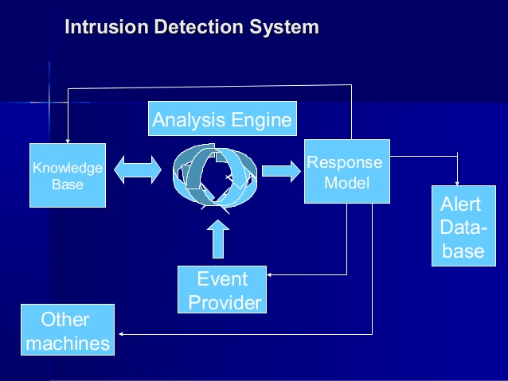

Slide 96

Evaluation of IDS’s

Slide 97
Intrusion Detection Systems (IDS)
Intrusion Detection Systems look for attack signatures, which are specific patterns that usually indicate malicious or suspicious intent.

Slide 98


Slide 99


Slide 100


Slide 101


Slide 102


Slide 103


Slide 104


Slide 105


Slide 106


Slide 107
Currently Available IDSs
Network Based IDS | Host Based IDS
Internet Security Systems Real Secure | Internet Security Systems Real Secure
Symantec Net Prowler | Symantec Intruder Alert
Network Ice Black Ice Defender | Tripwire
CyberSafe Centrax | Cyber Safe Centrax
Detection Appliance
Snort, Fragroute /Fragrouter, OSSEC HIDS, are some of the most popular Open Source IDS

Slide 108
Intrusion Detection Systems (IDS)
Different ways of classifying an IDS
IDS based on
anomaly detection
signature based misuse
host based
network based

Slide 109
Anomaly based IDS
This IDS models the normal usage of the network as a noise characterization.
Anything distinct from the noise is assumed to be an intrusion activity.
E.g flooding a host with lots of packet.
The primary strength is its ability to recognize novel attacks.

Slide 110
Drawbacks of Anomaly detection IDS
Assumes that intrusions will be accompanied by manifestations that are sufficiently unusual so as to permit detection.
These generate many false alarms and hence compromise the effectiveness of the IDS.

Slide 111
Signature based IDS
This IDS possess an attacked description that can be matched to sensed attack manifestations.
The question of what information is relevant to an IDS depends upon what it is trying to detect.
E.g DNS, FTP etc.

Slide 112
Signature based IDS (contd.)
ID system is programmed to interpret a certain series of packets, or a certain piece of data contained in those packets,as an attack. For example, an IDS that watches web servers might be programmed to look for the string “phf” as an indicator of a CGI program attack.
Most signature analysis systems are based off of simple pattern matching algorithms. In most cases, the IDS simply looks for a sub string within a stream of data carried by network packets. When it finds this sub string (for example, the ``phf'' in ``GET /cgi-bin/phf?''), it identifies those network packets as vehicles of an attack.

Slide 113
Drawbacks of Signature based IDS
They are unable to detect novel attacks.
Suffer from false alarms
Have to programmed again for every new pattern to be detected.

Slide 114
Host/Applications based IDS
The host operating system or the application logs in the audit information.
These audit information includes events like the use of identification and authentication mechanisms (logins etc.) , file opens and program executions, admin activities etc.
This audit is then analyzed to detect trails of intrusion.

Slide 115
Drawbacks of the host based IDS
The kind of information needed to be logged in is a matter of experience.
Unselective logging of messages may greatly increase the audit and analysis burdens.
Selective logging runs the risk that attack manifestations could be missed.

Slide 116
Strengths of the host based IDS
Attack verification
System specific activity
Encrypted and switch environments
Monitoring key components
Near Real-Time detection and response.
No additional hardware

Slide 117
Stack based IDS
They are integrated closely with the TCP/IP stack, allowing packets to be watched as they traverse their way up the OSI layers.
This allows the IDS to pull the packets from the stack before the OS or the application have a chance to process the packets.

Slide 118
Network based IDS
This IDS looks for attack signatures in network traffic via a promiscuous interface.
A filter is usually applied to determine which traffic will be discarded or passed on to an attack recognition module. This helps to filter out known un-malicious traffic.

Slide 119
Strengths of Network based IDS
Cost of ownership reduced
Packet analysis
Evidence removal
Real time detection and response
Malicious intent detection
Complement and verification
Operating system independence

Slide 120
Commercial ID Systems
ISS – Real Secure from Internet Security Systems:
Real time IDS.
Contains both host and network based IDS.
Tripwire – File integrity assessment tool.
Bro and Snort – open source public-domain system.

Slide 121
Bro: Real time IDS
Network based IDS
Currently developed for six Internet applications: FTP, Finger, Portmapper, Ident, Telnet and Rlogin.

Slide 122
Design goals for Bro
High-speed, large volume monitoring
No packet filter drops
Real time notification
Mechanism separate from policy
Extensible
Monitor will be attacked

Slide 123
Structure of the Bro System
Policy Script Interpreter
Real time notification
Policy script
Event Control
Event Stream
Event engine
Tcpdump filter
Filtered Packet Stream
libcap
Packet Stream
Network

Slide 124
Bro - libcap
It’s the packet capture library used by tcpdump.
Isolates Bro from details of the network link technology.
Filters the incoming packet stream from the network to extract the required packets.
E.g port finger, port ftp, tcp port 113 (Ident), port telnet, port login, port 111 (Portmapper).
Can also capture packets with the SYN, FIN, or RST Control bits set.

Slide 125
Bro – Event Engine
The filtered packet stream from the libcap is handed over to the Event Engine.
Performs several integrity checks to assure that the packet headers are well formed.
It looks up the connection state associated with the tuple of the two IP addresses and the two TCP or UDP port numbers.
It then dispatches the packet to a handler for the corresponding connection.

Slide 126
Bro – TCP Handler
For each TCP packet, the connection handler verifies that the entire TCP Header is present and validates the TCP checksum.
If successful, it then tests whether the TCP header includes any of the SYN/FIN/RST control flags and adjusts the connection’s state accordingly.
Different changes in the connection’s state generate different events.

Slide 127
Policy Script Interpreter
The policy script interpreter receives the events generated by the Event Engine.
It then executes scripts written in the Bro language which generates events like logging real-time notifications, recording data to disk or modifying internal state.
Adding new functionality to Bro consists of adding a new protocol analyzer to the event engine and then writing new events handlers in the interpreter.

Slide 128
Application Specific Processing - Finger
Tests for buffer overflow, checks the user against sensitive ids, etc
Script interpreter
Generates event controls based on the policy
Generates Finger_request event
Event Engine
Event Engine
Finger reply
Finger request

Slide 129
SNORT
Open source NIDS developed by Sourcefire
It combines the benefits of signature based and behavior based intrusion detection techniques
It has 300,000 registered users

Slide 130

How to install SNORT (in Linux)
http://www.youtube.com/watch?v=TZ0Hj0t5b5k&feature=related
How to install and use SNORT (in XP)
http://www.youtube.com/watch?v=nAWN989WA0A&feature=related
carbo.dll is the file that can be used to remotely view any file your web server has permissions to view

Slide 131
http://www.snort.org
Need to define signatures/rules
available on internet, updated frequently
Multiple level architecture
Main application (doing analysis)
Web client – ACID (Analysis Console for Intrusion Databases)
Barnyard – analysis of results

Slide 132
Now supports preprocessor analysis
Problems with signatures
False positives – too wide a net
False negatives – too narrow a net
Preprocessors allow customizing
Start using anomaly-based detection
Customize rules based on users
Examples (see in /etc/snort/snort.conf)
stream4 – TCP statefulness, session reassembly
frag2 – packet fragmenting/reassembly
Problems
Difficult to work with, generates large amount of data

Slide 133
Future of IDS
To integrate the network and host based IDS for better detection.
Developing IDS schemes for detecting novel attacks rather than individual instantiations.

